Slide 1

IS-907 - Active Shooter
What You Can Do?

Slide 2
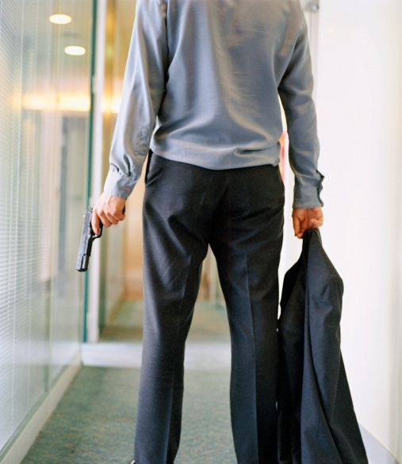
  DISPATCHER:
  “911, what is the nature of your emergency?”
  CALLER:
  “There’s somebody with a gun in the main entrance to the mall and I don’t . . .”
  Active shooter situations are unpredictable and evolve quickly.
  Are you prepared?
Notes:
As we delve into this presentation let's start by setting clear objectives for what we aim to achieve in this course.
We aim to:
Describe actions to take when confronted with:
An active shooter.
Law enforcement officers who are responding to the situation.
Recognize potential workplace violence indicators.
Describe actions to take to prevent and prepare for potential active shooter incidents.
Describe how to manage the consequences of an active shooter incident.
In the next few slides, we will dive into each of these objectives in detail, equipping you with valuable knowledge and strategies to enhance your preparedness and response in active shooter situations. So, let's get started with the first objective.

Slide 3
Course Objectives
  Describe actions to take when confronted with:
    An active shooter.
    Law enforcement officers who are responding to the situation.
  Recognize potential workplace violence indicators.
  Describe actions to take to prevent and prepare for potential active shooter incidents.
  Describe how to manage the consequences of an active shooter incident.
Notes:
As we delve into this presentation let's start by setting clear objectives for what we aim to achieve in this course.
We aim to:
Describe actions to take when confronted with:
An active shooter.
Law enforcement officers who are responding to the situation.
Recognize potential workplace violence indicators.
Describe actions to take to prevent and prepare for potential active shooter incidents.
Describe how to manage the consequences of an active shooter incident.
In the next few slides, we will dive into each of these objectives in detail, equipping you with valuable knowledge and strategies to enhance your preparedness and response in active shooter situations. So, let's get started with the first objective.

Slide 4



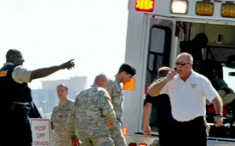
Active Shooter Incidents
Where we:
  Shop
  Exercise free speech
  Learn
  Work
Notes:
Now, let's talk about "Active Shooter Incidents." These are situations that can occur in various places where we go about our daily lives:
- While shopping
- During exercises of free speech
- In educational institutions where we learn
- At our workplaces
These incidents can happen unexpectedly, and it's crucial to be aware of what actions we can take to protect ourselves and others. Let's delve into this topic and explore what you can do in such scenarios to stay safe and respond effectively.

Slide 5

About Active Shooter Incidents
  More frequent.
  Anger, revenge, ideology, untreated mental illness.
Notes:
Active Shooter incidents are becoming more frequent in various settings, and it's crucial to understand some key factors:
First, the motives behind these incidents can vary, including factors like anger, revenge, ideology, or untreated mental illness.
Secondly, it's essential to recognize that employees and individuals like yourselves play a vital role in both preventing and preparing for these situations.
Today, we'll explore the actions you can take to enhance your readiness and potentially prevent these incidents from occurring in your workplace and community.

Slide 6

Active Shooter Situations
  Unpredictable.
  Evolve quickly.
  Continue until stopped by law enforcement, suicide, or intervention.
Notes:
Now, let's focus on "Active Shooter Situations." These are characterized by several critical points that we must be aware of:
First, they are unpredictable. These incidents can occur suddenly and without warning.
Second, they evolve rapidly, which means that the situation can change within moments.
And third, active shooter situations typically continue until they are halted by law enforcement, the individual involved takes their own life, or someone intervenes effectively.
Given this unpredictability and the rapid pace at which these situations unfold, it's crucial to be prepared and informed about what actions you can take to protect yourself and others.
We'll be discussing these actions in detail as we progress through this presentation.

Slide 7

Course Topics

Slide 8
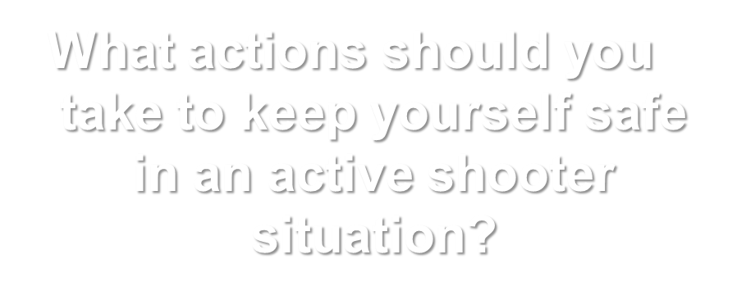
Discussion: Response
Notes:
Now, let's engage in a crucial discussion about the response actions you should take to ensure your safety in an Active Shooter (AS) situation.
This topic is of utmost importance, and we're here to explore the steps and strategies you can employ to protect yourself and others when faced with such a situation.
We'll delve into these response actions in detail, providing you with valuable insights and guidance to enhance your preparedness and confidence in the face of an Active Shooter incident.

Slide 9
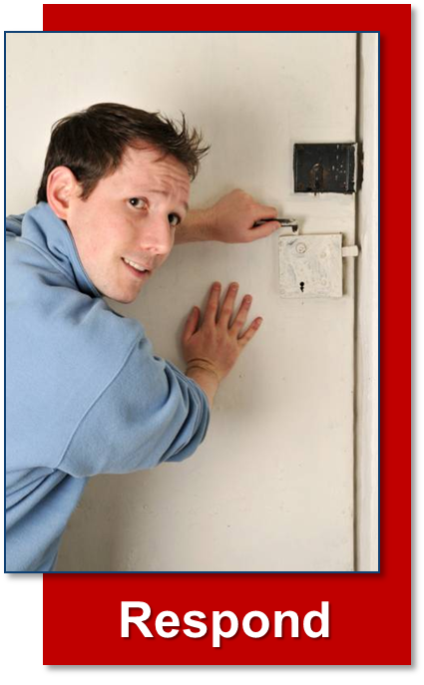
How To Respond
Run
Hide
Fight

Slide 10


Run (1 of 2)
  Have an escape route and plan in mind.
  Leave your belongings behind.
  Help others escape, if possible.
  Evacuate regardless of others.
  Warn/prevent individuals from entering.
Notes:
Now, we're diving into the first response action: "Run." In the event of an Active Shooter situation, it's essential to act swiftly and decisively. Here's what you should do:
Have an escape route and plan in mind: Familiarize yourself with your surroundings and identify potential escape routes. Knowing where to go can save crucial seconds.
Leave your belongings behind: Your safety is the top priority. Don't waste time gathering personal belongings; leave them behind.
Help others escape if possible: If you can assist others without compromising your safety, do so. Encourage them to run with you.
Evacuate regardless of others: If others are hesitant or unsure, don't wait for them. Your goal is to get to safety as quickly as possible.
Warn/prevent individuals from entering: If you encounter people unaware of the danger, warn them and prevent them from entering the danger zone. Your actions can save lives.

Slide 11


Run (2 of 2)
  Do not attempt to move wounded people.
  Keep your hands visible.
  Follow police instructions.
  Call 911 when safe.
Notes:
Remember:
Do not attempt to move wounded people: Your priority is your own safety. In an active shooter situation, it's crucial not to try to move or assist wounded individuals, as this can put you in harm's way.
Keep your hands visible: Make sure your hands are visible to law enforcement officers. This helps them identify you as a non-threat when they arrive on the scene.
Follow police instructions: When law enforcement arrives, listen carefully to their instructions and follow them promptly. They are there to handle the situation and ensure your safety.
Call 911 when safe: Once you have reached a safe location, call 911 to report the incident and provide any critical information you may have about the situation.
Remember, the "Run" response is about getting yourself to safety as quickly as possible while following these important guidelines to maximize your safety and the effectiveness of law enforcement response. We'll continue to explore the remaining response actions in the upcoming slides.

Slide 12

Hide
  Your hiding spot should:
    Be out of the active shooter’s view.
    Provide protection if shots are fired.
    Not restrict options for movement.
Notes:
Now, let's discuss the "Hide" response action. This is another critical step to remember in an Active Shooter situation. Here's what you should keep in mind:
Your hiding spot should be out of the active shooter's view: Find a location where you are not visible to the shooter. This can increase your chances of staying safe.
Provide protection if shots are fired: Your hiding spot should also offer some form of protection, such as a solid barrier, to shield you from harm in case shots are fired.
Not restrict options for movement: Ensure that your hiding place does not restrict your ability to move or escape if the situation changes. Flexibility is key.
Remember, "Hide" is about finding a safe location where you can stay out of harm's way. We'll continue to explore the remaining response actions to ensure you are well-prepared for any scenario.

Slide 13

Keeping Yourself Safe While Hiding
  If the shooter is nearby:
  Lock the door.
  Hide behind large item (e.g., cabinet, desk).
  Silence cell phone/pager.
  Remain quiet.
Notes:
Now, let's discuss how to keep yourself safe while hiding. This is crucial information, especially if the shooter is nearby. Here are the key steps to follow:
Lock the door: If possible, lock the door to the room where you are hiding. This can provide an additional layer of security.
Hide behind a large item: Find a substantial object, such as a cabinet or desk, to shield yourself from view. This can help protect you from potential gunfire.
Silence your cell phone/pager: Ensure that your electronic devices are in silent mode. You don't want any noise to give away your location.
Remain quiet: Stay as quiet as possible. Avoid making any unnecessary noise that could alert the shooter to your presence.
These actions can significantly increase your chances of staying safe while you're in a hiding position. We'll continue to explore other response actions in the upcoming slides to provide you with a comprehensive understanding of what you can do in an active shooter situation.

Slide 14

Important Information
Provide law enforcement or 911 operators with:
  Location of shooter.
  Number of shooters.
  Physical description of shooters.
  Number and types of weapons.
  Number of potential victims.
Notes:
In an active shooter situation, providing accurate and timely information to law enforcement or 911 operators is crucial. Here's what you need to convey:
Location of the shooter: Be as specific as possible when describing the shooter's location within the building or area. This information helps law enforcement respond quickly.
Number of shooters: Determine whether there is more than one shooter. This detail helps authorities assess the scope of the situation.
Physical description of shooters: If you can, provide a physical description of the shooter(s), including clothing, height, build, and any distinguishing features.
Number and types of weapons: Report the number and types of weapons the shooter(s) may have. This information aids law enforcement in preparing for the situation.
Number of potential victims: If you are aware of the number of potential victims, share this with 911 operators. It helps them allocate resources effectively.
Remember, your ability to provide this critical information can assist law enforcement in responding more efficiently, potentially minimizing the impact of the active shooter situation.

Slide 15

Fight
  As an absolute last resort:
    Act as aggressively as possible.
    Throw items and use improvised weapons.
    Work together to incapacitate the shooter.
    Commit to your actions.
Notes:
Now, let's discuss the "Fight" response, which should only be considered as an absolute last resort. If you find yourself in a situation where there are no other options, here's what you should do:
Act as aggressively as possible: Your goal is to overwhelm and incapacitate the shooter. Act with determination and aggression.
Throw items and use improvised weapons: Use whatever objects you can find as improvised weapons. Throwing items or striking the shooter can disrupt their focus.
Work together to incapacitate the shooter: If there are others with you, coordinate your efforts to incapacitate the shooter. There is strength in numbers.
Commit to your actions: Be fully committed to your actions. This is a fight for your life and the lives of others, so give it your all.
Remember, the "Fight" response is a last resort when there are no other options available. It is a challenging and dangerous course of action, but it may be necessary to protect yourself and others. We'll continue to explore additional response actions in the following slides.

Slide 16
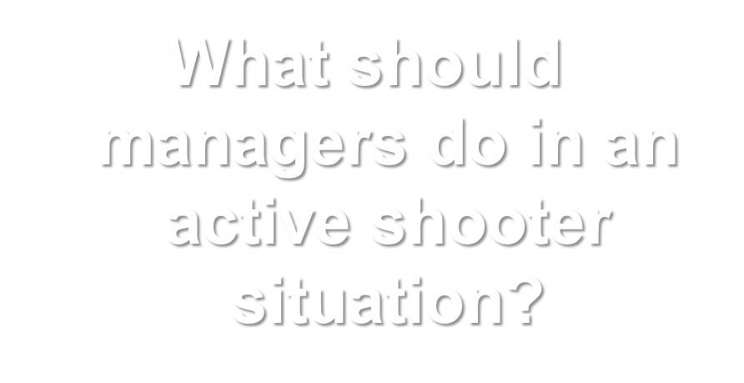
Discussion: Reaction of Managers
Notes:
Now, let's engage in a discussion about the reaction of managers in an active shooter situation. It's essential to understand the responsibilities and actions that managers should take when such a crisis occurs.
We'll explore the key steps and strategies that managers can employ to ensure the safety of their teams and employees.
This discussion will provide valuable insights into the role of leadership in responding to and managing an active shooter incident within the workplace. Let's delve into this important topic together.

Slide 17
Activity: What Would You Do?
Instructions: Working as a team:
    Look around the room. Consider what you would do in an active shooter situation and whether it would be better to run or hide.
    Come up with a list of actions you would take to protect yourself and those around you.
Notes:
Now, it's time for an interactive activity. I want you to work as a team on this one.
Here are your instructions:
Look around the room: Take a moment to assess your surroundings.
Consider what you would do in an active shooter situation: Think about whether it would be better to run or hide, given your current location.
Come up with a list of actions: Collaborate with your team to create a list of actions you would take to protect yourself and those around you.
This activity encourages you to think critically and plan how you would respond in an active shooter situation. It's an opportunity to brainstorm and learn from each other's insights. Take your time, and when you're ready, we'll hear from your spokesperson.

Slide 18

Discussion: When Law Enforcement Arrives
Notes:
Now, let's engage in a discussion about what actions you should take when law enforcement arrives during an active shooter situation. This is a critical topic, as law enforcement plays a crucial role in resolving these incidents.
We'll explore the steps and behaviors that will help law enforcement identify you as a non-threat and effectively manage the situation. It's important to understand how to respond appropriately to their presence, as it can make a significant difference in ensuring your safety and the safety of others. Let's discuss this vital aspect together.

Slide 19
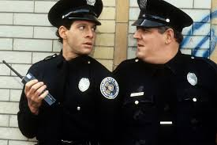
Law Enforcement’s Role
  Immediate purpose:
  Stop the active shooter.
  Proceed to area where last shots heard.
  First priority is to eliminate the threat.
Notes:
Now, let's discuss the critical role of law enforcement in an active shooter situation. When law enforcement arrives, their immediate purpose is clear:
Stop the active shooter: Their primary goal is to stop the threat posed by the active shooter. This is their top priority.
Proceed to the area where the last shots were heard: Law enforcement will move swiftly to the location where the last shots were reported, as this is where the immediate danger is.
First priority is to eliminate the threat: Their utmost priority is to eliminate the active shooter and neutralize the threat to ensure the safety of everyone in the vicinity.
Understanding law enforcement's role is essential because it helps you know what to expect when they arrive on the scene. Their swift and decisive actions are aimed at ensuring your safety and the safety of others. We'll continue to explore more aspects of active shooter response in the upcoming slides.

Slide 20
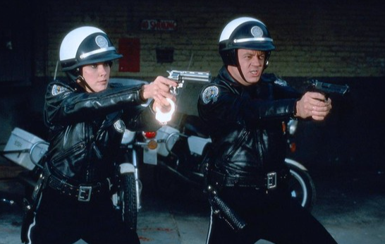
Additional Officers and Rescue Teams
  Teams may:
  Wear bulletproof vests, helmets, and other equipment.
  Be armed with rifles, shotguns, and/or handguns.
  Use pepper spray.
  Shout commands.
  Push individuals to the ground for their safety.
Notes:
Now, let's talk about the presence of additional officers and rescue teams in an active shooter situation. These teams play a vital role in securing the area and ensuring your safety. Here's what you should know:
Teams may wear bulletproof vests, helmets, and other equipment: It's common for these teams to wear protective gear to shield themselves from potential harm.
They may be armed with rifles, shotguns, and/or handguns: These officers are typically armed with various firearms to address the threat effectively.
Use of pepper spray: In some cases, pepper spray may be used to incapacitate the shooter or gain control of the situation.
Shouting commands: You may hear loud and authoritative commands from these teams as they work to restore order.
Push individuals to the ground for their safety: In certain situations, individuals may be directed to the ground for their safety as officers and rescue teams take control.
Understanding the presence and actions of additional officers and rescue teams is essential for your safety. Their coordinated efforts are focused on neutralizing the threat and ensuring the well-being of everyone involved. We'll continue to explore more aspects of active shooter response in the upcoming slides.

Slide 21
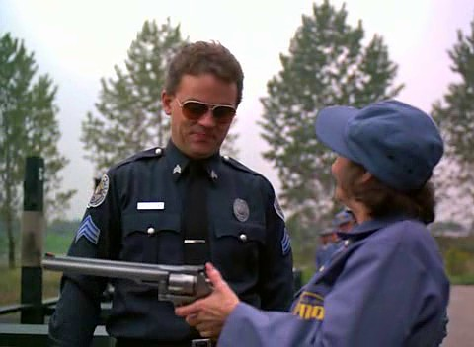
Reacting to Law Enforcement
  Remain calm.
  Put down any items.
  Raise hands and spread fingers.
  Avoid quick movements.
  Avoid pointing, screaming, or yelling.
  Proceed in direction from which officers are entering.
Notes:
Now, let's discuss how to react when law enforcement arrives during an active shooter situation. Your safety and the safety of others depend on your actions in this critical moment. Here's what you should do:
Remain calm: It's essential to stay calm and composed. Law enforcement is there to help, and your cooperation is vital.
Put down any items: If you're holding any objects, put them down slowly and carefully. This helps officers see that you are not a threat.
Raise hands and spread fingers: Raise your hands in a visible and non-threatening manner. Spread your fingers so that officers can see you're not holding a weapon.
Avoid quick movements: Make slow and deliberate movements. Sudden actions can be misinterpreted, so move carefully.
Avoid pointing, screaming, or yelling: Keep your voice low and avoid pointing at anyone. Shouting or sudden gestures can create confusion.
Proceed in the direction from which officers are entering: Follow their instructions. They will guide you to safety, and it's essential to comply with their directions.
Remember, the primary goal is to ensure everyone's safety, and your cooperation with law enforcement is crucial in achieving that. Staying calm and following their instructions will help resolve the situation safely.

Slide 22

Safe Location
  Area controlled by law enforcement until:
    The situation is under control.
    All witnesses are identified and questioned.

Slide 23



Course Topics
Respond
Prepare
Follow Up

Slide 24
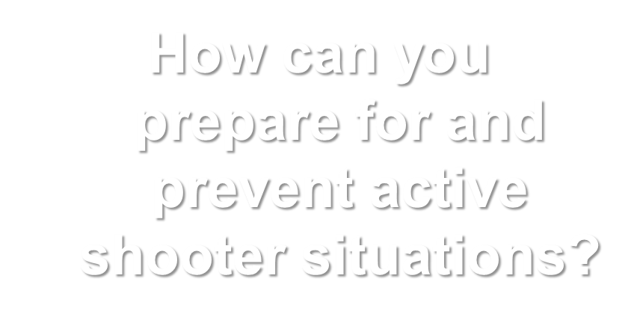
Discussion: Preparation
Notes:
It's essential to understand that while we hope never to encounter such a situation, preparedness can make a significant difference.
I encourage you all to share your thoughts, insights, and strategies on how individuals and communities can be proactive in preventing and preparing for these incidents.
Let's open the floor for discussion.

Slide 25
How To Prepare
  Develop an Emergency Action Plan.
  Conduct training.
  Recognize indicators of potential workplace violence.
Notes:
Now, let's delve into how you can prepare effectively to respond to an active shooter situation. Preparation is key to ensuring your safety and the safety of those around you. Here's what you can do:
Develop an Emergency Action Plan: It's crucial to have a well-thought-out Emergency Action Plan in place. This plan should outline steps to follow in case of an active shooter incident. Make sure everyone in your organization or community is aware of this plan.
Conduct Training: Regular training sessions like this one are essential. They help individuals understand their roles and responsibilities during an active shooter situation. Training can include simulations and drills to ensure that everyone knows how to respond effectively.
Recognize Indicators of Potential Workplace Violence: Being vigilant and recognizing potential indicators of workplace violence is a proactive step. By identifying warning signs early, you can take steps to prevent incidents before they occur.
Preparing for an active shooter situation is a collective effort, and it requires both planning and awareness. Your active involvement in these preparation steps can make a significant difference in enhancing safety.

Slide 26

Developing an Emergency Action Plan
  Get input from:
  Human resources department.
  Training department.
  Facility owners/operators.
  Property manager.
  Local law enforcement and emergency responders.
Notes:
Let's discuss the critical steps in developing an effective Emergency Action Plan. To create a comprehensive plan, it's crucial to gather input and collaborate with various stakeholders. Here's who you should involve:
Human Resources Department: Your HR team can provide valuable insights into employee safety and well-being. They can help identify specific personnel-related considerations.
Training Department: The training department can contribute by designing and implementing training programs to ensure that everyone knows how to respond in an active shooter situation.
Facility Owners/Operators: Those responsible for the physical premises should be consulted to address building-specific concerns and security measures.
Property Manager: If your organization operates within a larger facility or complex, the property manager can offer insights into overall security and access control.
Local Law Enforcement and Emergency Responders: Collaborating with local law enforcement and emergency responders is vital. They can provide valuable guidance and coordinate response efforts effectively.
By involving these key stakeholders in the development of your Emergency Action Plan, you ensure a well-rounded and comprehensive approach to preparedness. It's a collaborative effort that enhances safety for all.

Slide 27
Components of an Effective Plan
  A preferred method for reporting different types of emergencies
  An evacuation policy and procedure
  Emergency escape procedures and route assignments
  Contact information for individuals to be contacted under the Emergency Action Plan
  Information concerning local area hospitals
  An emergency notification system to alert various parties of an emergency
Notes:
Now, let's break down the key components that make up an effective Emergency Action Plan. These elements are crucial for ensuring a well-prepared response to an active shooter situation:
A Preferred Method for Reporting Different Types of Emergencies: It's essential to have a clear and reliable way to report emergencies promptly. This could be a dedicated phone number, radio channel, or communication system.
An Evacuation Policy and Procedure: Define the procedures for evacuating the premises safely. This includes identifying exit routes, assembly areas, and roles during evacuation.
Emergency Escape Procedures and Route Assignments: Assign specific responsibilities for guiding people to safety during an emergency. Clearly mark escape routes and ensure everyone understands their roles.
Contact Information for Individuals to Be Contacted Under the Emergency Action Plan: Maintain an updated list of contacts who need to be notified in case of an emergency, including employees, emergency services, and other relevant parties.
Information Concerning Local Area Hospitals: Provide information about nearby hospitals and medical facilities where injured individuals can receive prompt medical attention.
An Emergency Notification System: Implement a reliable emergency notification system to quickly alert relevant parties about the situation. This could include alarms, intercoms, or automated messaging systems.
Each of these components plays a vital role in an effective Emergency Action Plan, ensuring a coordinated and efficient response in the event of an active shooter incident.

Slide 28

Conducting Training
  Employee training should include:
  Identifying the sound of gunfire.
  Reacting quickly.
  Calling 911.
  Reacting when law enforcement arrives.
  Adopting a survival mindset during a crisis.
Notes:
Now, let's delve into the critical aspect of conducting training to prepare for active shooter situations. It's essential that employees are well-prepared and know how to respond effectively. Here are the key components of employee training:
Identifying the Sound of Gunfire: Training should help employees recognize the sound of gunfire, so they can differentiate it from other noises in the environment. This early awareness is crucial for a rapid response.
Reacting Quickly: Emphasize the importance of swift action. In an active shooter situation, every second counts. Employees should know how to react immediately to protect themselves and others.
Calling 911: Ensure that employees are familiar with the process of calling 911. Provide clear instructions on what information to provide to emergency services, such as the location and the number of shooters.
Reacting When Law Enforcement Arrives: Training should cover how to interact with law enforcement when they arrive on the scene. Employees should remain calm, follow instructions, and avoid making sudden movements.
Adopting a Survival Mindset During a Crisis: Encourage employees to adopt a survival mindset. This means staying focused on staying safe and doing whatever is necessary to survive while waiting for help.
By providing comprehensive training that covers these crucial aspects, you can empower your employees to respond effectively in the event of an active shooter incident, increasing their chances of staying safe and assisting others.

Slide 29
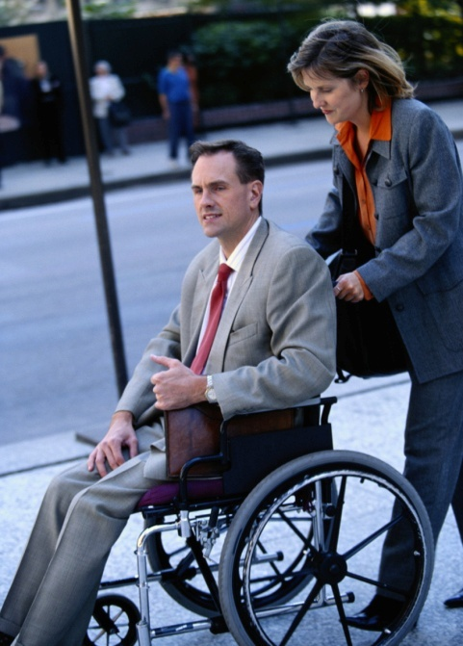
Meet Everyone’s Needs
  Ensure that plans assess and provide for functional needs:
  Hearing or sight
  Mobility
  Limited or no English proficiency
Notes:
Now, let's discuss a crucial aspect of emergency planning - meeting everyone's needs. It's vital to ensure that our plans are inclusive and address the diverse needs of all individuals. Here are some key considerations:
Hearing or Sight Impairments: We must take into account individuals with hearing or sight impairments. Ensure that emergency communications are accessible, such as providing visual alerts for those with hearing impairments and audible alerts for those with sight impairments.
Mobility Challenges: Individuals with mobility challenges may require special assistance during an emergency. Have plans in place to assist them in evacuating safely, which may include accessible exits and equipment.
Limited or No English Proficiency: Language barriers can be a significant challenge during emergencies. Identify individuals with limited or no English proficiency and have resources available to communicate with them effectively, such as bilingual staff or translated materials.
By considering these factors and tailoring our plans to meet everyone's needs, we can ensure that our response to active shooter situations is inclusive and effective, leaving no one behind.

Slide 30

Facility Manager Responsibilities (1 of 2)
  Institute access controls.
  Distribute critical items.
  Assemble crisis kits.
  Activate the emergency notification system.
  Ensure two evacuation routes.
  Coordinate with the facility’s security department.
Notes:
Now, let's dive into the responsibilities of facility managers in preparing for active shooter situations. Facility managers play a crucial role in ensuring the safety of everyone within a building. Here are some key responsibilities:
Institute Access Controls: It's essential to have control over who enters the facility. Implement access controls to monitor and restrict entry, ensuring that unauthorized individuals cannot easily enter.
Distribute Critical Items: Facility managers should be prepared to distribute critical items, such as first-aid kits, communication devices, or other emergency supplies, as needed during an active shooter incident.
Assemble Crisis Kits: Having crisis kits readily available is vital. These kits should contain essential supplies like medical supplies, emergency contact information, and any necessary tools for managing the situation.
Activate the Emergency Notification System: In case of an active shooter situation, facility managers should promptly activate the emergency notification system to alert everyone within the building and notify authorities.
Ensure Two Evacuation Routes: It's crucial to have at least two evacuation routes planned and well-marked. In an emergency, having multiple exit options can be a lifesaver.
Coordinate with the Facility’s Security Department: Collaborate closely with the facility's security department to ensure a coordinated response. This includes sharing information, communicating effectively, and working together to mitigate the threat.
These are some of the key responsibilities of facility managers when it comes to active shooter preparedness. Their proactive actions can make a significant difference in ensuring the safety of all occupants.

Slide 31

Facility Manager Responsibilities (2 of 2)
  Post evacuation routes.
  Place removable floor plans near entrances and exits.
  Include law enforcement and first responders in training.
  Encourage active shooter training.
  Foster a respectful workplace.
  Be aware of workplace violence indicators.
Notes:
Post Evacuation Routes: Facility managers should make sure that evacuation routes are clearly posted throughout the building. This means that in case of an emergency, everyone knows exactly where to go to exit safely.
Place Removable Floor Plans Near Entrances and Exits: It's a good practice to have removable floor plans near entrances and exits. These plans can assist law enforcement and first responders in quickly understanding the layout of the building, helping them navigate and respond effectively.
Include Law Enforcement and First Responders in Training: Collaboration with law enforcement and first responders is essential. Facility managers should involve them in training sessions to ensure a coordinated response during an active shooter incident.
Encourage Active Shooter Training: Promote active shooter training among all employees within the facility. Encouraging everyone to be prepared and know how to react can save lives.
Foster a Respectful Workplace: Creating a respectful and positive workplace culture can help reduce the risk of workplace violence incidents. Encourage respect, open communication, and conflict resolution.
Be Aware of Workplace Violence Indicators: Facility managers should educate themselves and their teams about potential workplace violence indicators. Recognizing warning signs early can allow for intervention and prevention.
Facility managers play a critical role in ensuring the safety and preparedness of their buildings in active shooter situations. These responsibilities should not be taken lightly, and a proactive approach is essential to protect all occupants.

Slide 32






Recognizing Indicators of Violence

Slide 33

Workplace Violence Indicators
  May be current or former employee.
  May display characteristics of potentially violent behavior.
Notes:
Now, let's discuss the critical topic of recognizing workplace violence indicators. Identifying these signs is essential for maintaining a safe work environment. Here's what you should look out for:
Current or Former Employee: Be vigilant about the behavior of both current and former employees. It's not uncommon for individuals with grievances to act out, so keep an eye on their actions.
Characteristics of Potentially Violent Behavior: Pay attention to certain behaviors that could indicate a potential for violence. These might include aggressive outbursts, threats, intimidation, or a fascination with firearms and violence.
Recognizing these indicators early on allows for intervention and preventive measures, helping to reduce the risk of workplace violence incidents. Remember, it's everyone's responsibility to contribute to a safe and respectful workplace.

Slide 34

Managing the Consequences
  Determine who is missing or injured.
  Determine a method for notifying families.
  Assess psychological state of individuals.
  Identify and fill critical personnel or operational gaps.
Notes:
Now, let's talk about managing the aftermath of an active shooter incident. This is a critical phase, and here's what you need to do:
Determine who is missing or injured: After the incident, it's crucial to account for everyone and identify those who may be injured or missing. This information is essential for the next steps.
Determine a method for notifying families: Communicating with the families of those involved is essential. Have a plan in place for notifying them about the situation and the well-being of their loved ones.
Assess psychological state of individuals: Understand that people may be in shock or experiencing trauma. Assess the psychological state of individuals and provide support as needed.
Identify and fill critical personnel or operational gaps: During this crisis, identify any critical personnel or operational gaps that need immediate attention. Ensure that essential functions can continue smoothly.
Managing the consequences is a challenging task, but with a well-prepared response plan, you can minimize the impact and provide the necessary support to those affected.

Slide 35

Complete The Course
Use the link or the QR code below to complete this course and acquire your certification.
https://training.fema.gov/is/courseoverview.aspx?code=is-907

